Slide 1
PricewaterhouseCoopers
Web Qualifications
July 1999

Slide 2
TABLE of CONTENTS
Alberta Agriculture URL: http://www.agric.gov.ab.ca/………….……………………………... 5
American Family Insurance URL: http://www.amfam.com…………………………………………….. 6
Cambridge University Press URL: http://www.cup.org/……………………………………………….... 7
Compaq URL:http://www.compaq.com/activeanswers/about/lobby.html...……….. 8
Compaq URL: http://athome.compaq.com/…………...…………………………….. 9
Eukaltel URL: http://www.canal21.com……………………………………………. 10
Ginnie Mae URL: http://www.ginniemae.gov………………….………………………. 11
Habitrol URL: http://www.habitrol.com/french…………………………………….. 12
Indian Aluminum Company URL: www.indal.com……………………………………………………... 13
Intel URL: http://intelweboutfitter.com…….…………………………………... 14
Jute Manufactures Development Council URL: www.jute.com……………………………...……………………….. 15
Jute Manufactures Development Council URL: www.jmdcindia.com………………………………………………... 16
NASA URL: http://ifmp.nasa.gov/codeb/…………………………………………. 17
NECX URL: http://www.necx.com……………………………………………….. 18

Slide 3
TABLE of CONTENTS
Panasonic Factory Automation URL: http://www.panasonicfa.com………………………………….……. 19
PricewaterhouseCoopers URL: http://www.pwchealth.com………………………………………... 20
PricewaterhouseCoopers URL: http://ttiweb.philly.us.mcs.pw.com…………………………………. 21
PricewaterhouseCoopers URL: http://10.45.16.151………………………………………………….. 22
PricewaterhouseCoopers URL: http://www.sap.pwcglobal.com.……………………………………. 23
PricewaterhouseCoopers URL: http://www.supplychain.pwcglobal.com…………………………… 24
PricewaterhouseCoopers URL: http://www.vu.pwcglobal.com……………………………………… 25
PricewaterhouseCoopers URL: http://www.e-business.pwcglobal.com……………………………... 26
PricewaterhouseCoopers URL: http://www.pwcglobal.com.………………………………………… 27
PricewaterhouseCoopers URL: www.barometersurveys.com……………………………………….. 28
Saltlec Cyber Club Centre URL: www.indiainitiative.com……………………………………….…… 29
Sony Pictures Entertainment URL: http://cpweb.spe.sony.com…………………………………………. 30
UBS URL: http://sapwebp/cgi-bin/ndCGI/Pers/Login………..… ……………... 31
Universal Service Administrative Co. URL: www.rhc.univeresalservice.org…………………………………….. 32

Slide 4
TABLE of CONTENTS
United States Postal Service URL: http://pmgg.usps.com/……...………………………………………. 33
United States Postal Service URL: http://www.usps.com/ or http://www.usps.gov…………...………... 34
U.S. Department of Education URL: http://gapsweb.ed.gov/……………………………………………… 35
U.S. Department of Defense and Commerce URL:http://dodbusopps.com………………………………………………. 36

Slide 5
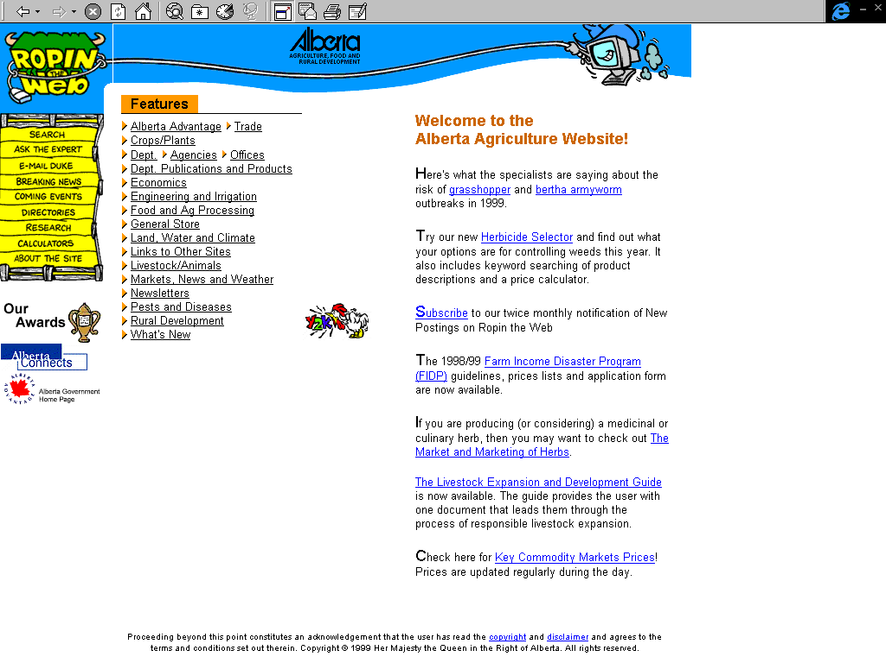
Alberta Agriculture
www.agric.gov.ad.ca
Project Profile:
Alberta Agriculture, Food and Rural Development a provincial government department in Alberta, commissioned PwC to design, develop and implement a web strategy in an effort to provide information, programs, and services to agriculture producers, agri-businesses, food processors, and to rural communities in Alberta, Canada. The site currently boasts over 25,000 pages of information, 1800 graphical representations, 12 calculators (e.g., to calculate fertilizer requirements for crops) with a new "Herbicide Selector" system to be released this winter, 15 audio clips which change weekly, a database of agriculture experts that is enabled by an application called "Ask the Expert", and 70,000 hypertext linkages. “Ropin’ the Web,” the designated name for this project is considered one of the pioneers in Internet Service in Canada. It was credited in 1996 with helping increase the number of Internet users in Alberta to over 20% of commercial farmers, while the Canadian national average was only 15%. The site now has over one million hits a month. Agricultural users considered this “greatest Aggie Internet site in the world.” Every month, users from over 100 countries use the site to connect with the export-oriented agriculture and food industry in Alberta.
PwC Contact:
Heather Meek

Slide 6
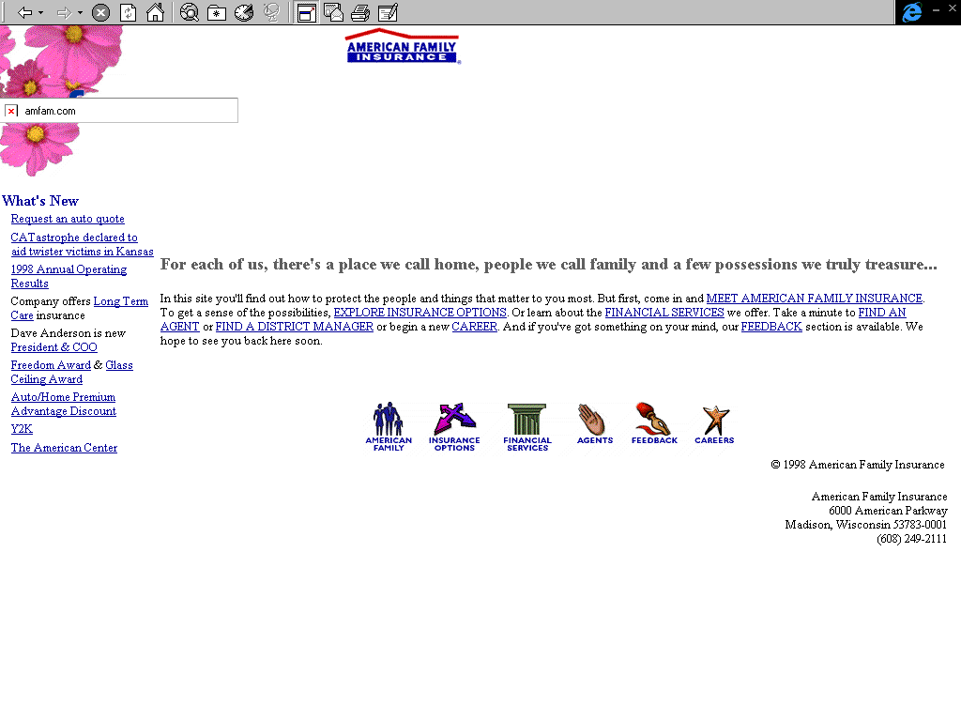
American Family Insurance
www.amfam.com
Project Profile:
PwC was engaged by American Family Insurance to develop a Web Architecture and develop a proof of concept prototype for the replacement of two agent management systems. There is potential for add on work of one to three million dollars.
PwC Contact:
Bill Loumpouridis

Slide 7
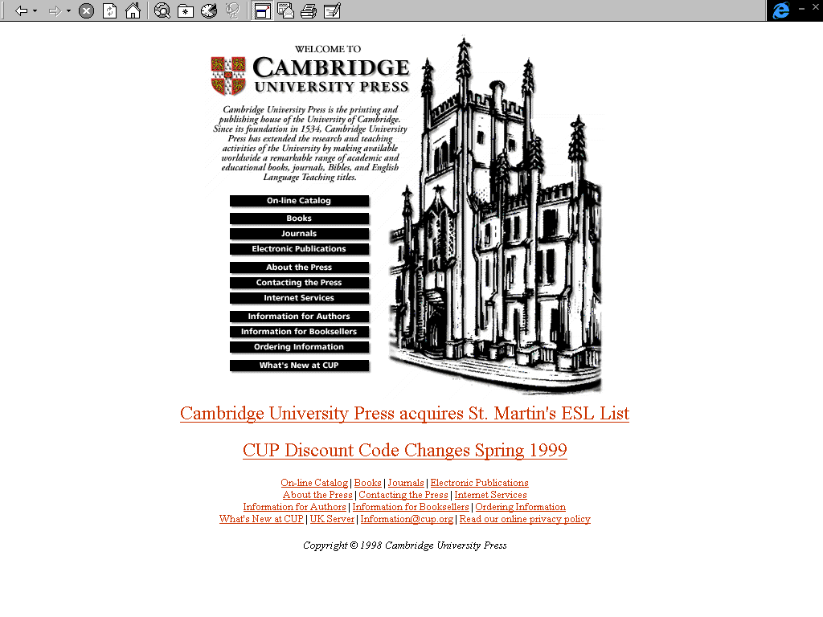
Cambridge University Press
www.cup.org
Project Profile:
As one of the most prestigious publishers of academic material Cambridge University Press provides a range of publications to a global customer base. Cambridge University Press recognized that the internet would facilitate immediate access to their customer base and desires, reduce the significant media distribution costs and enable them to provide new service offerings. An example of a new service offering would be to enabling selling of individual articles as opposed to a complete journal, or to provide focused client material. PwC was responsible for working with Cambridge University Press to develop, design, and implementing a web strategy. This strategy involved providing an outsourced internet service with the Web presence hosted in the USA, providing a Web publishing service managed in the UK, and developing an application which provides consumers with the ability to search and buy various media information. The system provides a subscription capability to build user groups and provides access to specialist content.
PwC Contact:
Colin Windsor

Slide 8
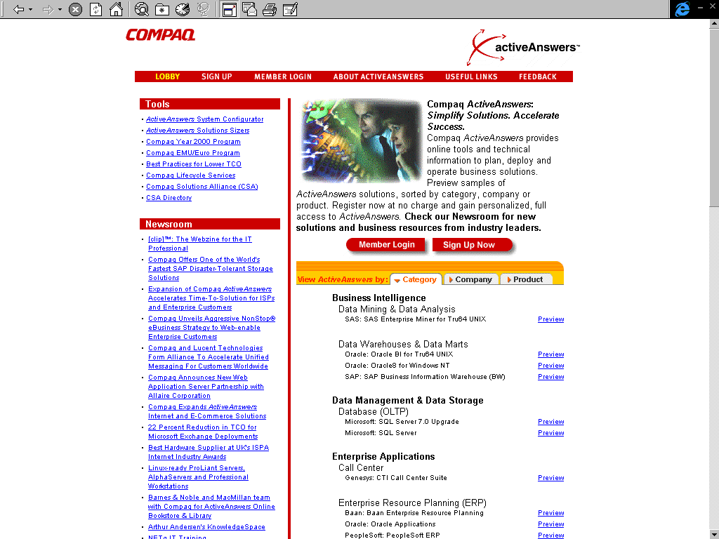
Compaq
www.compaq.com/activeanswers/about/lobby.html
Project Profile:
    Compaq is in the computer hardware business, selling a complete line of personal computers and servers for home and business. Compaq’s challenge was to go direct to consumers and preferred business customers through internet sales while providing their existing sales channel partners with additional internet and support capabilities. The internet (consumer) and extranet (preferred customer) sites use the same infrastructure globally, integrating with legacy systems and databases, allowing the addition of functionality and sites with minimal effort. These sites are accessible in multiple languages with information specific to Compaq’s global customers.
PwC Contact:
Philip Reilly

Slide 9
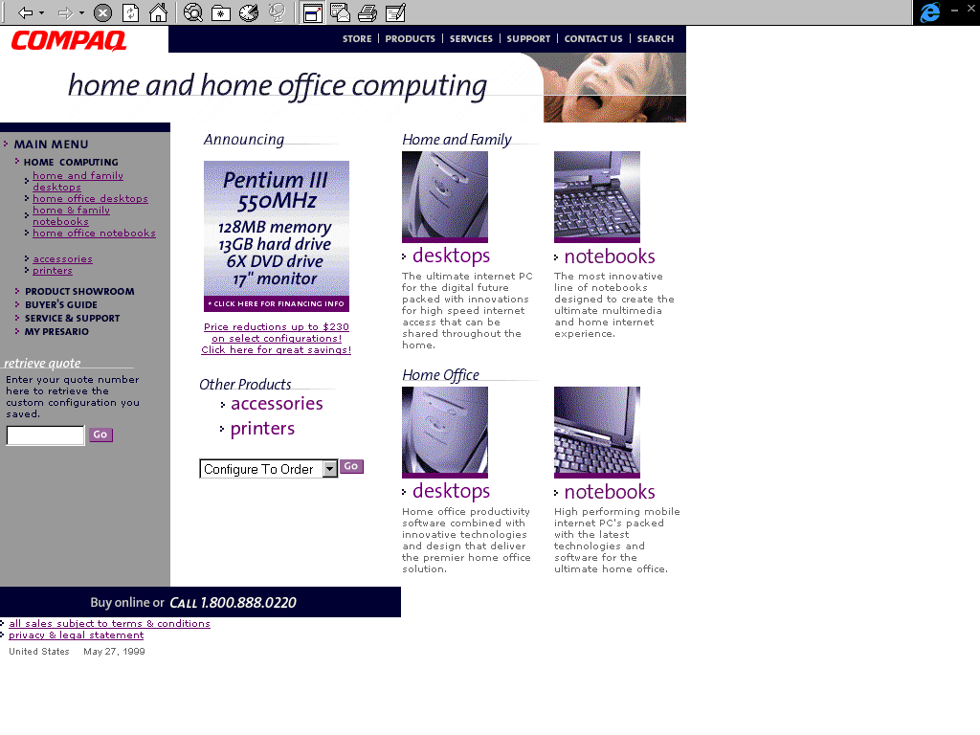
Compaq
http://athome.compaq.com
Project Profile:
    Compaq is in the computer hardware business, selling a complete line of personal computers and servers for home and business. Compaq’s challenge was to go direct to consumers and preferred business customers through internet sales while providing their existing sales channel partners with additional internet and support capabilities. The internet (consumer) and extranet (preferred customer) sites use the same infrastructure globally, integrating with legacy systems and databases, allowing the addition of functionality and sites with minimal effort. These sites are accessible in multiple languages with information specific to Compaq’s global customers.
PwC Contact:
Philip Reilly

Slide 10
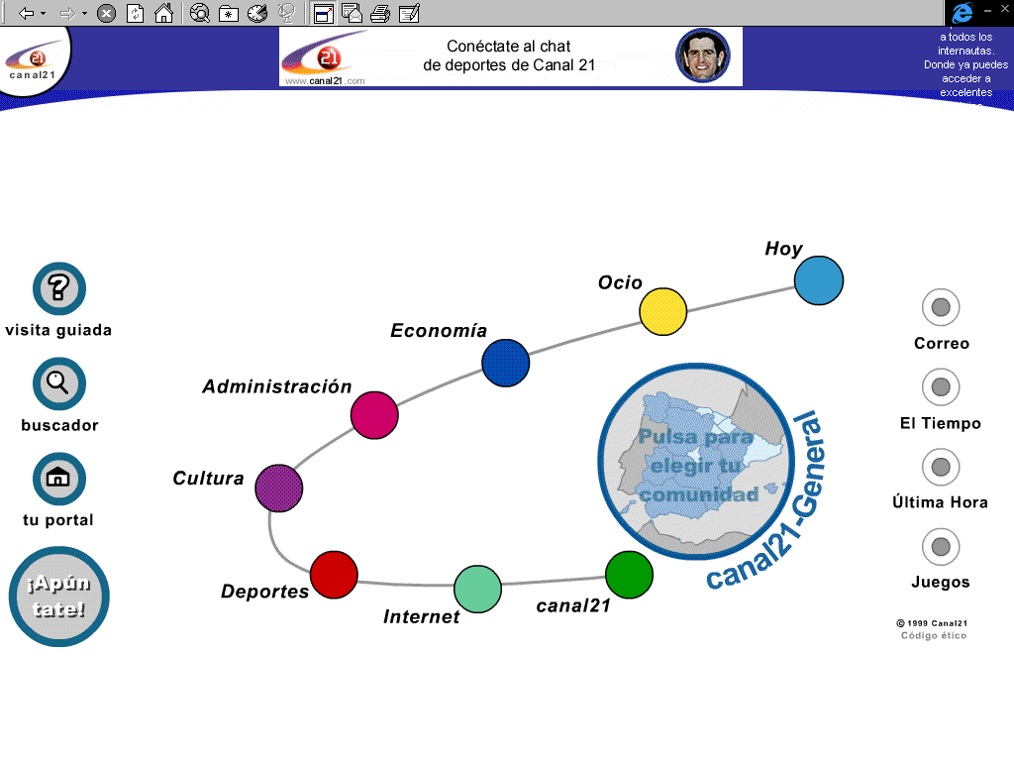
Eukaltel
www.canal21.com/
Project Profile:
www.canal21.com is a Spanish portal, in three languages (Spanish, Euskera and Catalan), focused on the follow areas: weather, news, games, cooking, dictionaries, directory, searcher, as well as stock market information. In the first month there were more than 2 million pages visited, and 6,500 users registered.
Eukaltel was a $450,000 project, created over a seven month period. PwC has defined the strategy of the project, the components, the software, as well as the relationships with the various partners involved in the project. In addition, PwC has created the directory, parts of the searcher and all of the systems based in VoIP.
PwC Contact:
Alvaro Castells (E-Business Manager). Madrid, Spain.

Slide 11
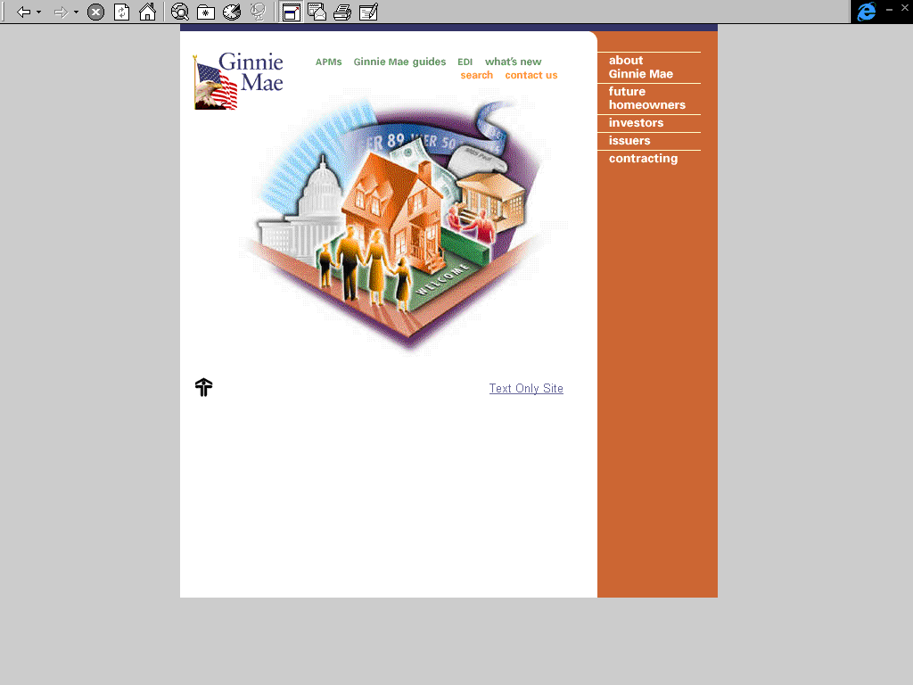
Ginnie Mae
www.ginniemae.gov
Project Profile:
Ginniemae.gov is the Web site for Ginnie Mae (Government National Mortgage Association). This web site is used by Consumers, Issuers (Ginnie Mae mortgage servicers) and Investors. The site provides information about Ginnie Mae in general as well as Issuer and Investor information. The site includes a Web-EDI application that allows Ginnie Mae Issuers to report their loan level servicing information on a quarterly basis. www.ginniemae.gov contains over 700 pages and documents, all of which is managed and maintained by PwC.
PwC/Ginnie Mae Systems Group is the developer, manager and host for the Ginnie Mae Web site and related applications. PwC is responsible for all content review and updates as provided by Ginnie Mae staff as well as propose recommendations to improving the navigation and overall functionality of the Web-site. PwC is also working on a second redesign of the entire Web-site, scheduled for an October 1, 1999 release date.
PwC Contact:
Michael Gabbay - (703) 322-5734

Slide 12
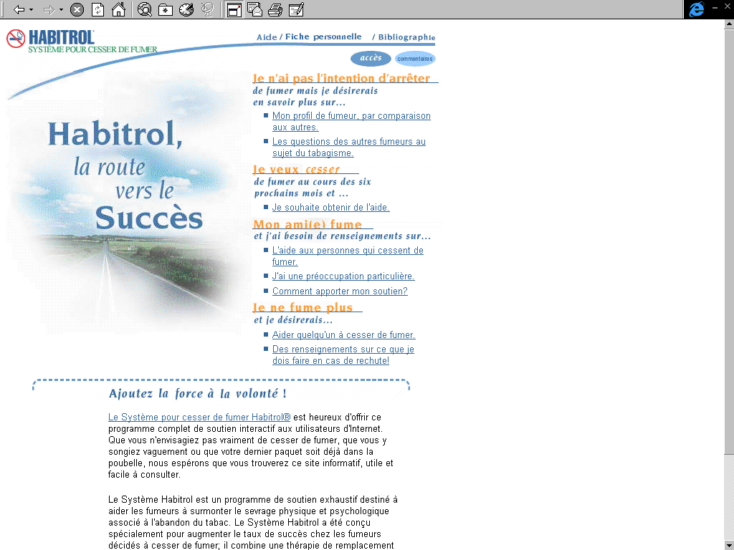
Habitrol
www.habitrol.com/french
Project Profile:
PwC Contact:
Jacqui Molenaar

Slide 13

Indian Aluminum Company
www.indal.com
Project Profile:
The Multimedia and Web Group at the Technology Centre of PwC Calcutta India has been entrusted with the contract for design, hosting and maintenance of the official web site of Indian Aluminum Company, Limited. on a turnkey basis. The server is hired from VERIO, a US based ISP, however INDAL has plan to move the server to ALCAN location. PwC will continue to provide services in design and maintenance of this site.
PwC Contact:
Dr. Suparno Chaudhuri, Calcutta, India, Ph: +91 33 476 1938, 475 2910
suparno.chaudhuri@in.pwcglobal.com

Slide 14
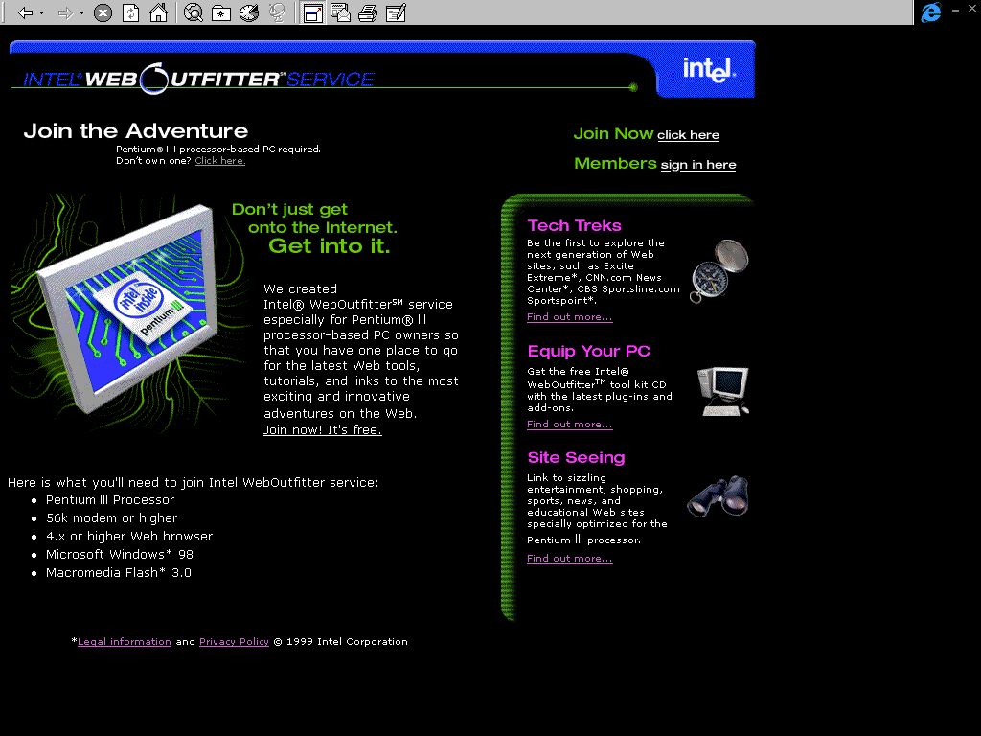
Intel
www.intelweboutfitter.com
Project Profile:
This is a customer loyalty and membership site. The content is optimized for the new PIII processor, utilizing Microsoft Technologies. This Intel site supports multiple languages/countries from the same set of servers.
PwC Contact:
Rip Sanders/MCS/Price Waterhouse, Kris Nayudu/MCS/Price Waterhouse

Slide 15
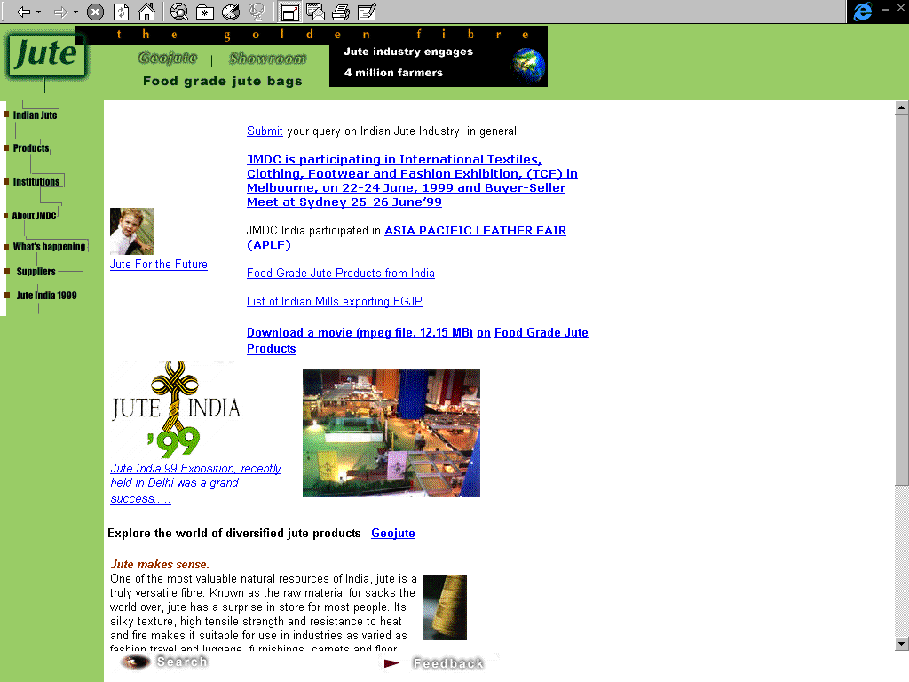
Jute Manufactures Development Council
www.jute.com
Project Profile:
PwC has done work to design, host and maintain the official web site of the Indian Jute Industry. The purpose of the site is to promote Jute as well as diversified Jute products in the global market. The site places a particular emphasis on the current perspective of the importance of Jute as an eco-friendly natural product.
PwC Contact:
Dr. Suparno Chaudhuri, Calcutta, India, Ph: +91 33 476 1938, 475 2910
suparno.chaudhuri@in.pwcglobal.com

Slide 16
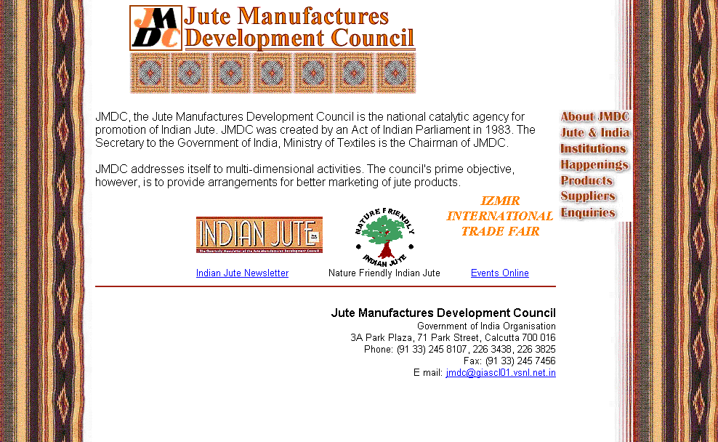
Jute Manufactures Development Council
www.jmdcindia.com
Project Profile:
Design, Hosting & Maintenance of the official web site of the Jute Manufactures Development Council. The purpose of the site is to detail activities and policies of the Government of India for the Indian Jute Industry. PwC India is also carrying out a consultation in strategy for re-engineering the Indian Jute Industry.
PwC Contact:
Dr. Suparno Chaudhuri, Calcutta, India, Ph: +91 33 476 1938, 475 2910
suparno.chaudhuri@in.pwcglobal.com

Slide 17
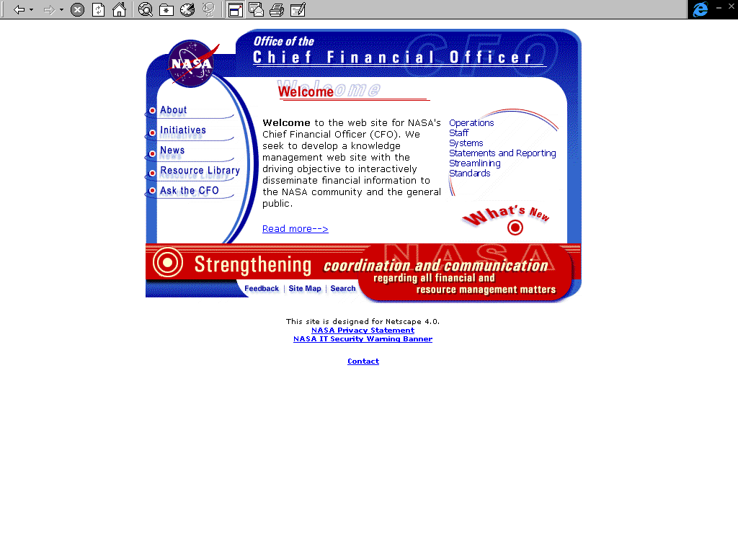
NASA
http://ifmp.nasa.gov/codeb
Project Profile:
PwC Contact:
Daimon Caulk

Slide 18
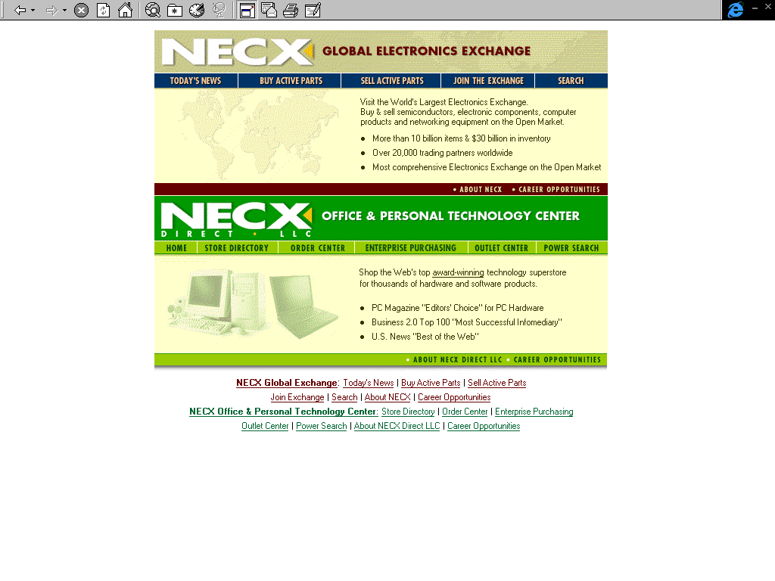
NECX
www.necx.com
Project Profile:
With the intention of leveraging the web for electronic commerce to increase sales, NECX commissioned PwC to develop a Web Strategy, Web Store, Manage enterprise selection, as well as Redesign on-line shopping and ordering strategies. The Strategies developed by PwC and NECX has resulted in www.necx.com becoming one of the busiest commercial web sites on the Internet.
PwC Contact:
Jeff Nickerson

Slide 19
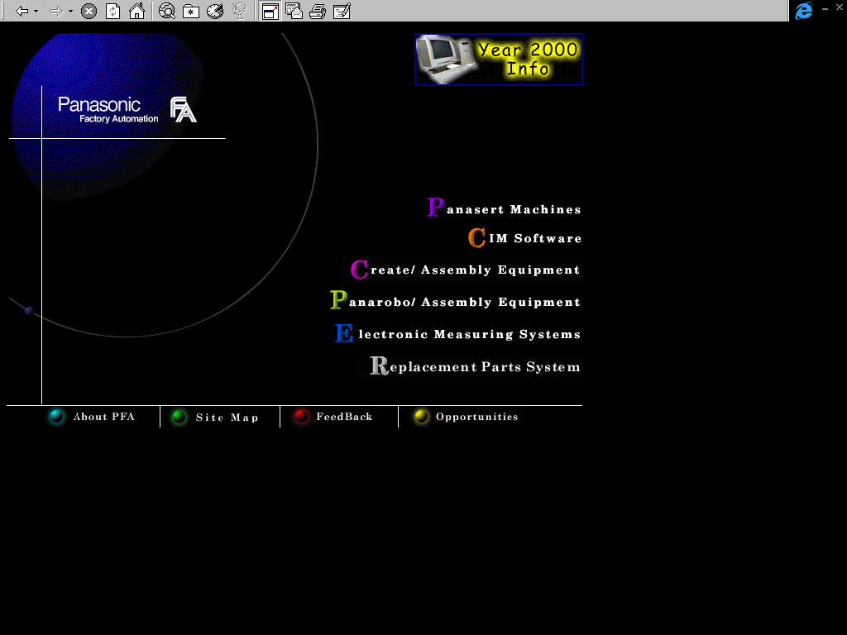
Panasonic Factory Automation
www.panasonicfa.com
Project Profile:
The aim of this project was to provide replacement parts data, such as the currently used part number, availability and process to Panasonic customers via the Internet. This information was being retrieved from the SAP system and Web pages were being created dynamically depending on the user queries. Price and discount information was user-(customer) specific and changed dynamically. Panasonic Factory Automation (PFA) engaged PwC to define the set of requirements for integrating PFA's existing Web site with its SAP implementation. The study focused on the parts replacement function
PwC Contact:
Uptal Amin

Slide 20
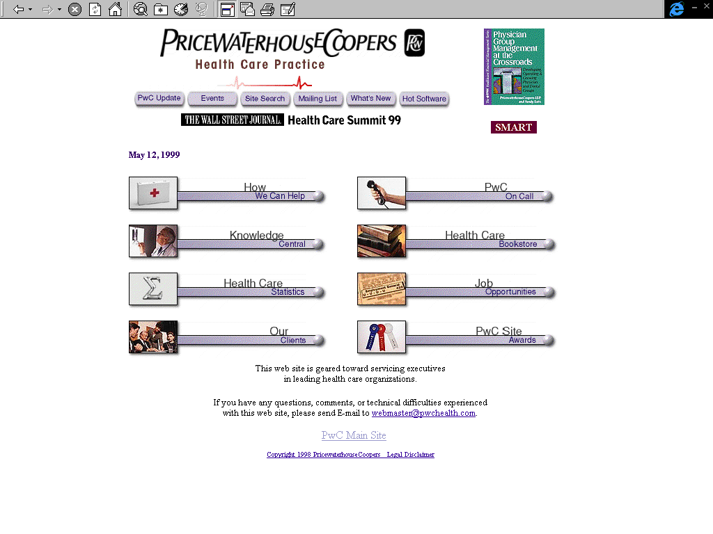
PricewaterhouseCoopers
www.pwchealth.com
Project Profile:
This web site is geared toward servicing executives in leading health care organizations while demonstrating PwC’s active role as thought leaders in the health care industry.
PwC Contact:
Chris Hornick (content and site project manager), Ann Kelleher (day to day site upkeep), Uri Kops (technical direction and site project management)

Slide 21
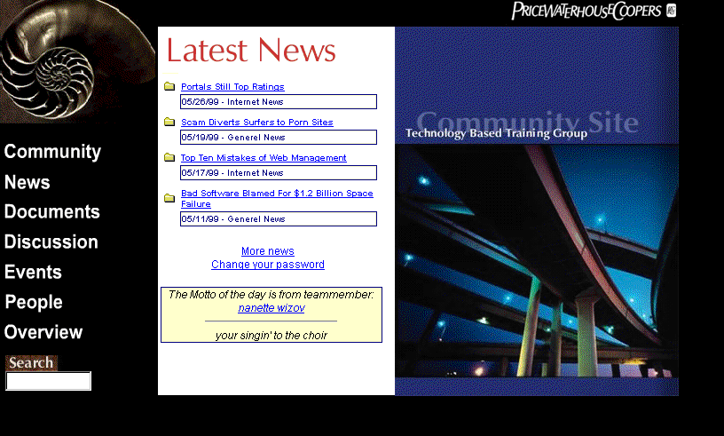
PricewaterhouseCoopers
http://10.13.112.15
Project Profile:
The TTI Web site is a knowledge-sharing tool for the TTI team. When the site is hit the following areas of the TTI curves appear: Enterprise Application Integration, E Business, ERP Development and Performance, ERP Infrastructure and Performance, Information Delivery, Systems Management and Workflow.
The curves use this information in order to:
Post training materials for other consultants, who can come in and learn about new technologies and download information about the technology.
Gather a list of internal and external contacts and rating our relationship with them.
Post news, documents and links about each curve.
Have discussion forums.
Hold information about each person and the skill sets in our Who’s Who section.
PwC Contact:
Joseph Washco, 215-575-5553

Slide 22
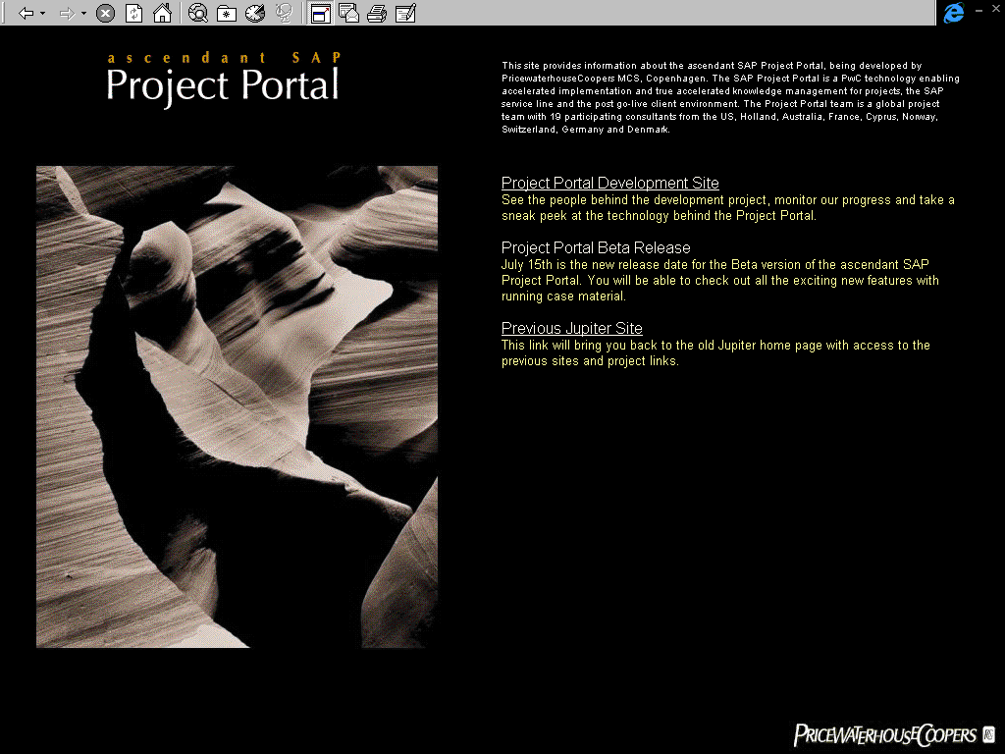
PricewaterhouseCoopers
http://10.45.16.151
Project Profile:
The SAP Project Portal is a PwC technology enabling accelerated implementation and true accelerated knowledge management for projects, the SAP service line and the post go-live client environment. The Project Portal team is a global project team with 19 participating consultants from the US, Holland, Australia, France, Cyprus, Norway, Switzerland, Germany and Denmark.
PwC Contact:
Kim Escherich

Slide 23
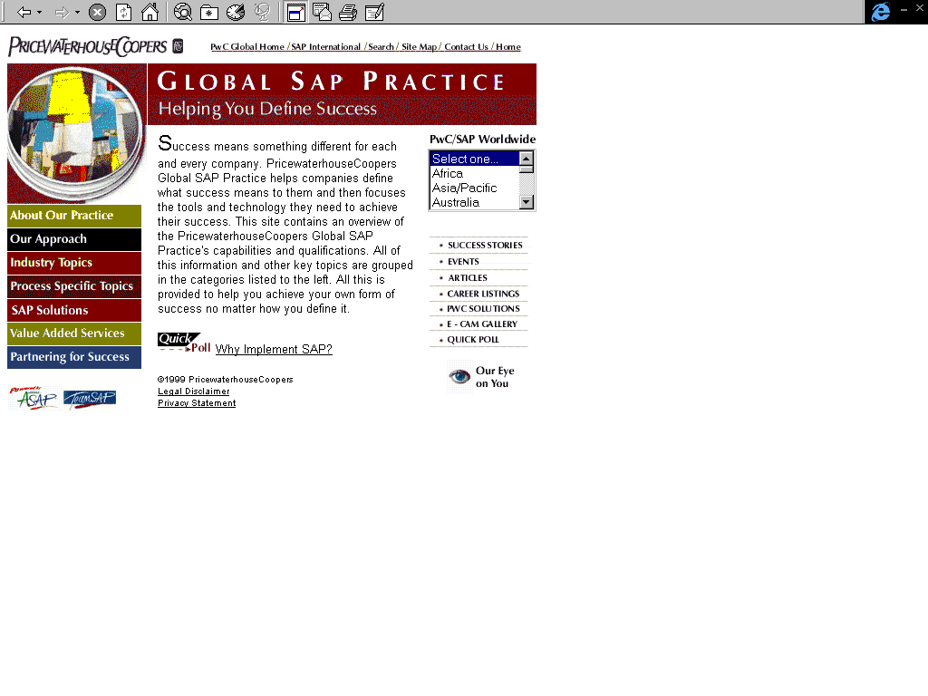
PricewaterhouseCoopers
www.sap.pwcglobal.com
Project Profile:
PwC Contact:

Slide 24
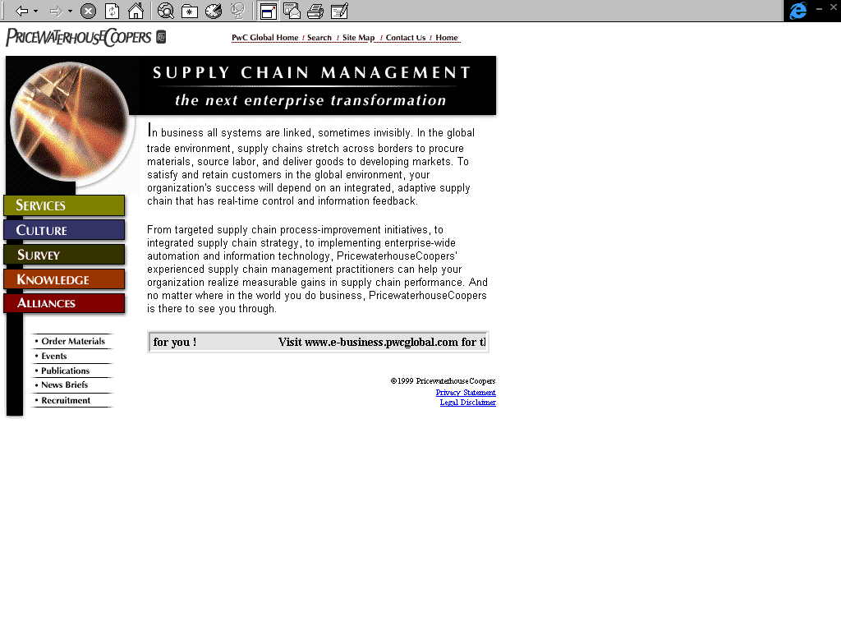
PricewaterhouseCoopers
www.supplychain.pwcglobal.com
Project Profile:
PwC Contact:

Slide 25
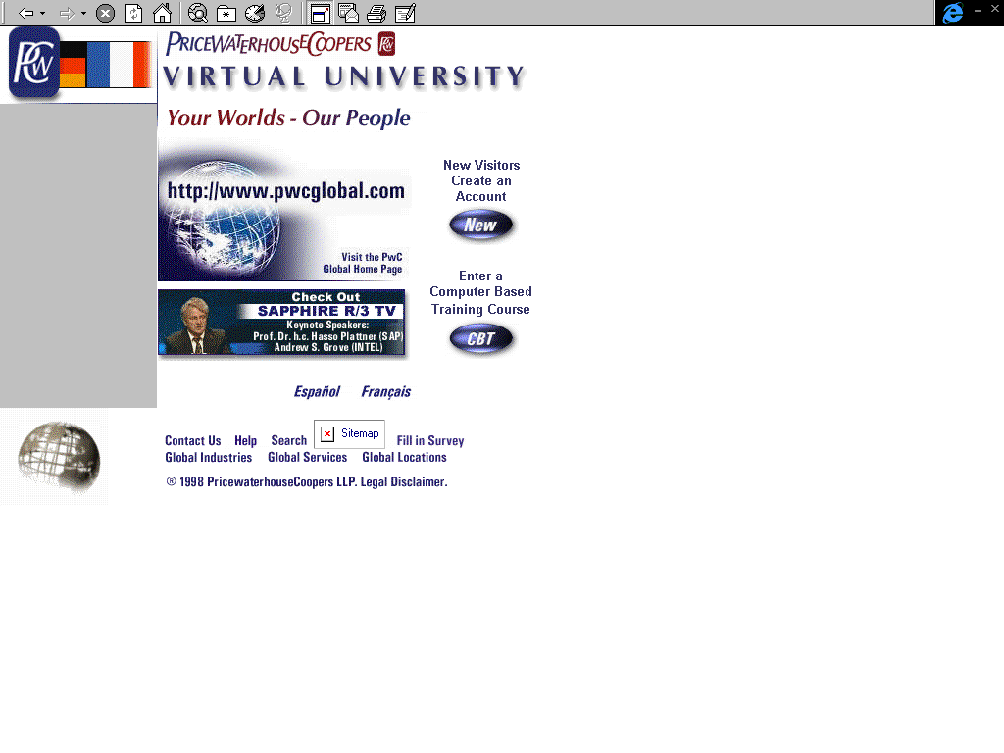
PricewaterhouseCoopers
www.vu.pwcglobal.com
Project Profile:
    The PricewaterhouseCoopers Virtual University (VU), based out of the PwC Global Training Centre (GTC) in Philadelphia, utilizes the Internet as a method for delivering computer based training (CBT) courses, multimedia clips of industry experts, and presentation material from classes offered at the Global Training Center (GTC). The main objective of the Virtual University is to provide PricewaterhouseCoopers consultants with a means to access training materials and Computer Based Training via the Internet and the PwC Intranet. The Virtual University provides computer-based training for Enterprise Resource Planning (ERP) courses, digitized video presentations of subject matter experts (as well as audio clips), access to ERP links on the web, ERP course listings, chat rooms and threaded discussions.
PwC Contact:
Michelle Sample

Slide 26
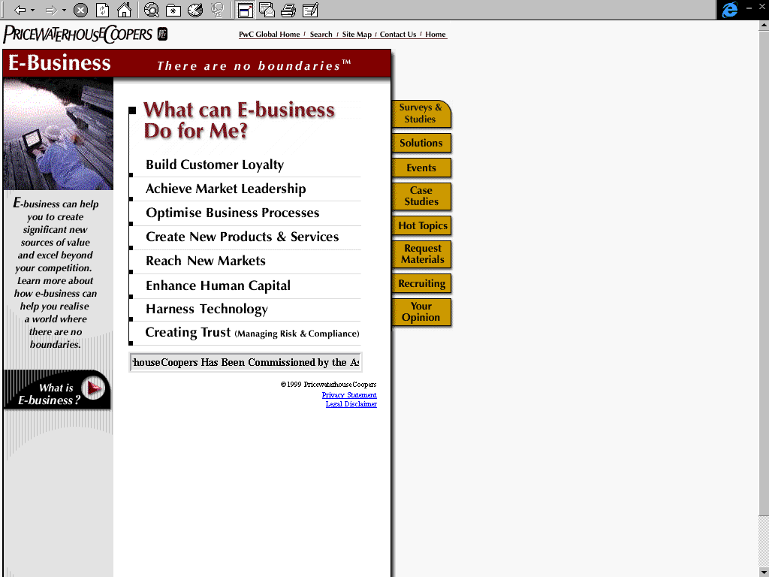
PricewaterhouseCoopers
www.e-business.pwcglobal.com
Project Profile:
PwC Contact:

Slide 27
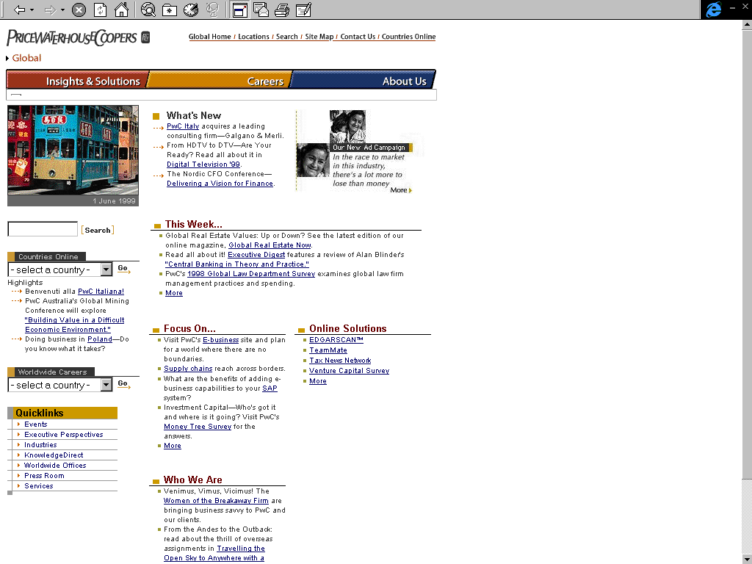
PricewaterhouseCoopers
www.pwcglobal.com
Project Profile:
PwC Contact:

Slide 28
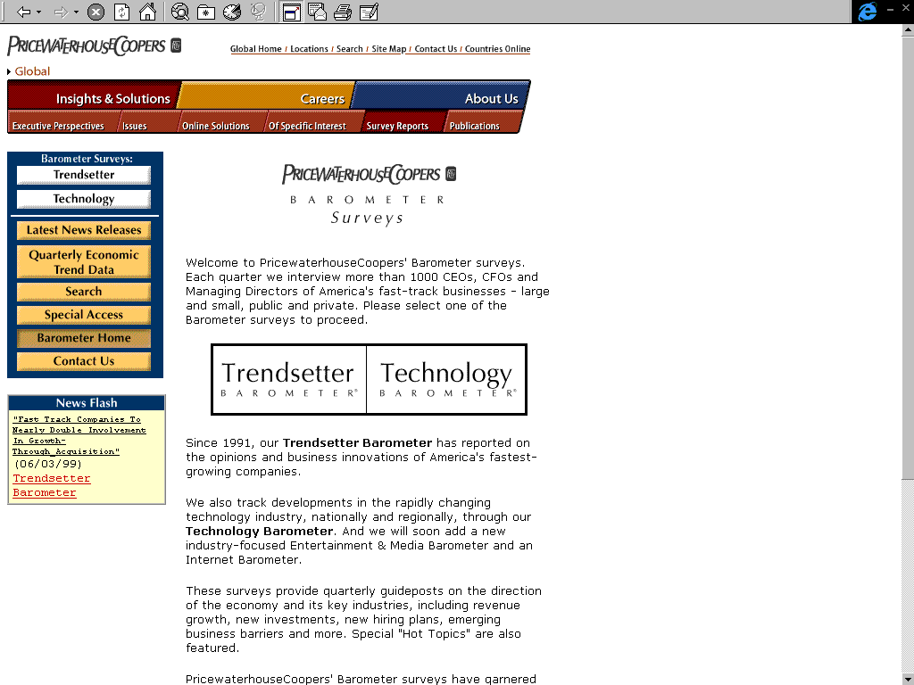
PricewaterhouseCoopers
www.barometersurveys.com
Project Profile:
This site profiles surveys of CEO’s of America’s fastest growing companies as well as surveys of CFO’s and Managing Directors of fast-growth technology businesses.
PwC Contact:
Pete Collins 212-259-4496

Slide 29
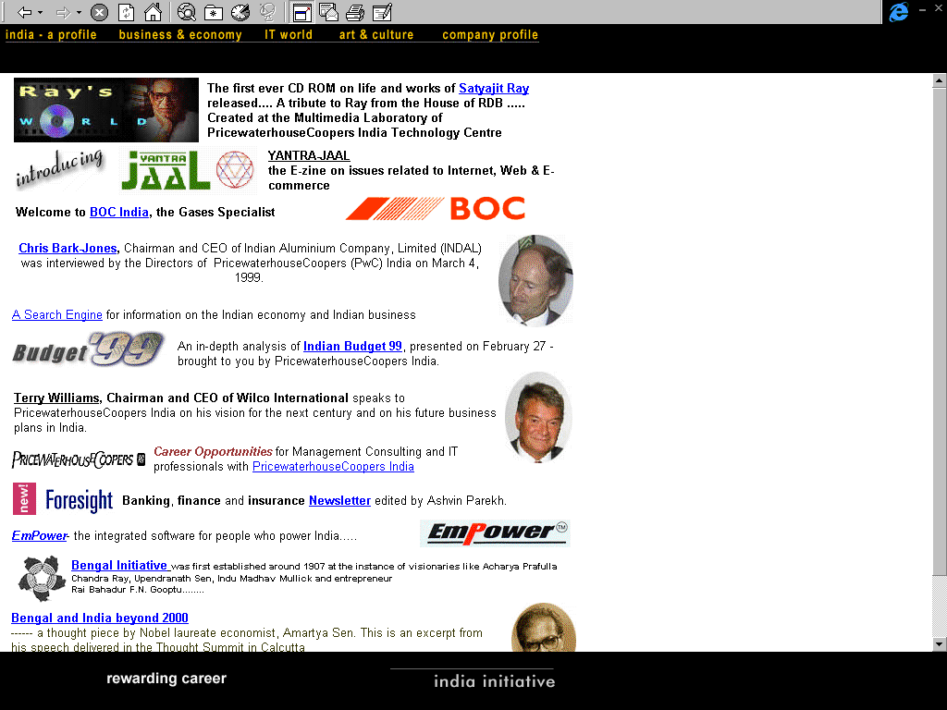
Saltlec Cyber Club Centre
www.indiainitiative.com
Project Profile:
www.indianitiavtive was developed to promote Indian Business & Industry with a special emphasis on IT. The site regularly publishes the following E-zines:
E-BIZ- an electronic newsletter on issues related to E-business
FORESIGHT - an electronic newsletter on Finance, Banking & Insurance Industry
RISK MONITOR - an electronic newsletter on issues related to Risk Management
www.indiainitiative.com covers the Indian Budget live every year with expert comments and analysis by Tax & Budget Experts. The site focuses on one major Indian company every month and publishes an interview of the CEO under the section "CEO of the Month". The site also covers major festivals, cultural events of India and regularly publishes Thought Pieces by eminent Indian personalities.
PwC Contact:
Dr. Suparno Chaudhuri, Calcutta, India, Ph: +91 33 476 1938, 475 2910
suparno.chaudhuri@in.pwcglobal.com

Slide 30
Sony Pictures Entertainment
http://cpweb.spe.sony.com
Project Profile:
PwC managed the implementation phase of the Sony Pictures Entertainment intranet project. PwC provided the technical resources to resolve environment and infrastructure issues. PwC also was responsible for completion of the initial applications. This was the first intranet site for SPE using Netscape and Microsoft technologies.
PwC Contact:
Mike Javadi

Slide 31
UBS
http://sapwebp/cgi-bin/ndCGI/Pers/Login
Project Profile:
Building on a successful SAP implementation project, PricewaterhouseCoopers developed an intranet based system for supporting bank management in budgeting activities. PwC’s Web technology based solution is fully integrated with SAP financial modules using Netdynamics SAP platform Adapter Components (PACS) and application development suite. PERS provides a facility for financial managers to track expenses on projects and producing client invoices. This one-step, automatic process significantly reduces the amount of time and effort previously required. While the project was completed in Stamford, Connecticut, and rolled out in New York, we are optimistic it will expand globally.
PwC Contact:
Josette Towles, 410-412-7884

Slide 32
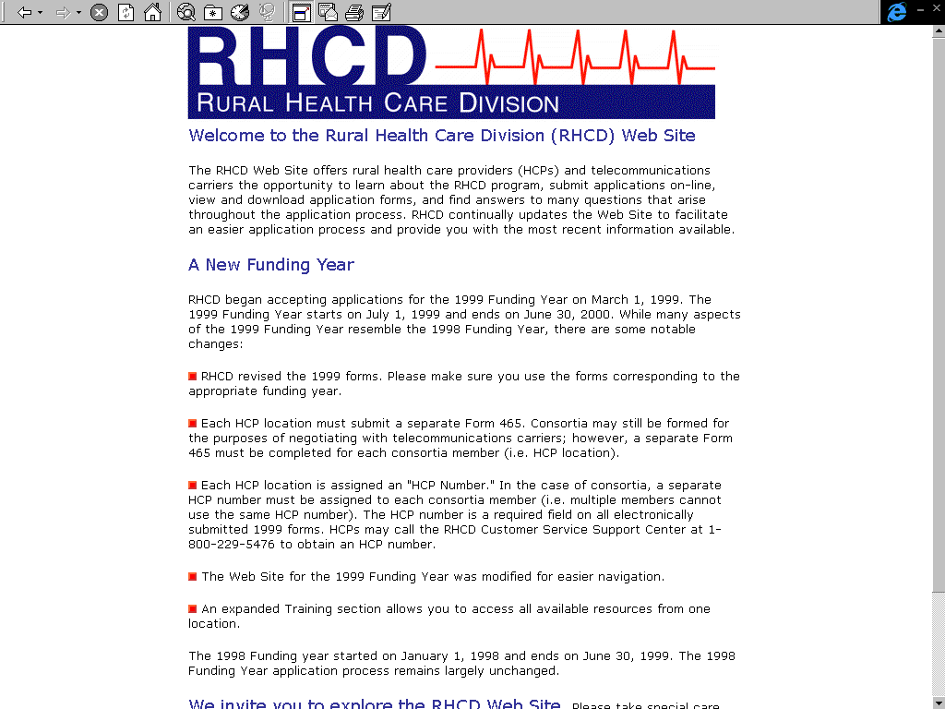
Universal Service Admin. Co. (RHCD)
www.rhc.universalservice.org
Project Profile:
The primary use of the RHCD funding is to support telemedicine programs. Telemedicine is the use of medical information exchanged from one site to another via electronic communications for the health and education of the patient or health care provider and for improving patient care.
This web site allows rural health care providers and the telecommunications carriers to submit their requests and program applications on-line via the World Wide Web. The Customer Service Support Center processes these requests and applications via the Intranet. RHCD hired PricewaterhouseCoopers to design and implement the RHCD’s business operation in the following areas: Conceptualize, develop, and maintain the RHCD web site, Processing all program applications, Defining subsidy criteria, Calculating subsidy amounts, Managing the funds transfer among health care providers, telecommunications carriers, and USAC.
This web site: Provides on-line support and information to rural health care providers and telecommunication carriers on all facets of the program, Enables Health Care Providers and telecommunications carriers to submit applications on-line in order to speed the application process and reduce RHCD's administrative costs, Provides telecommunications carriers on-line access to information in order to make business decisions regarding which health care providers to market
PwC Contact:
Project Partner: Paul Lawrence, Project Manager: Petre Snegireff

Slide 33
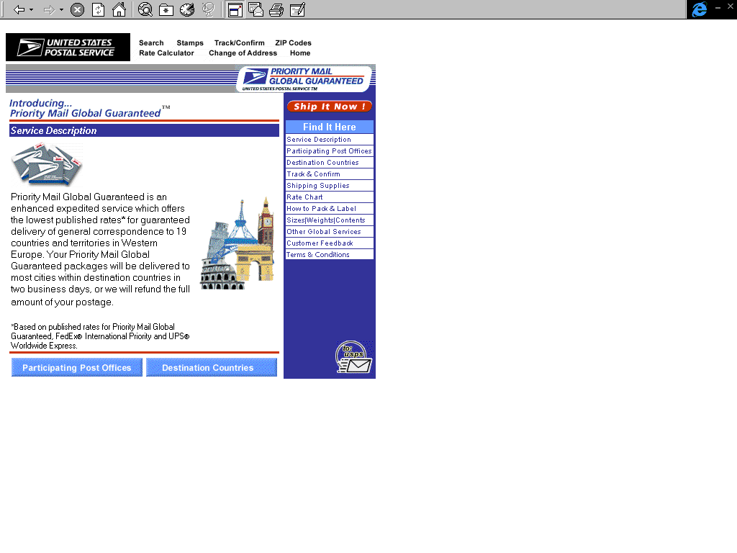
United States Postal Service
http://pmgg.usps.com
Project Profile:
PwC Contact:
Daimon Caulk

Slide 34
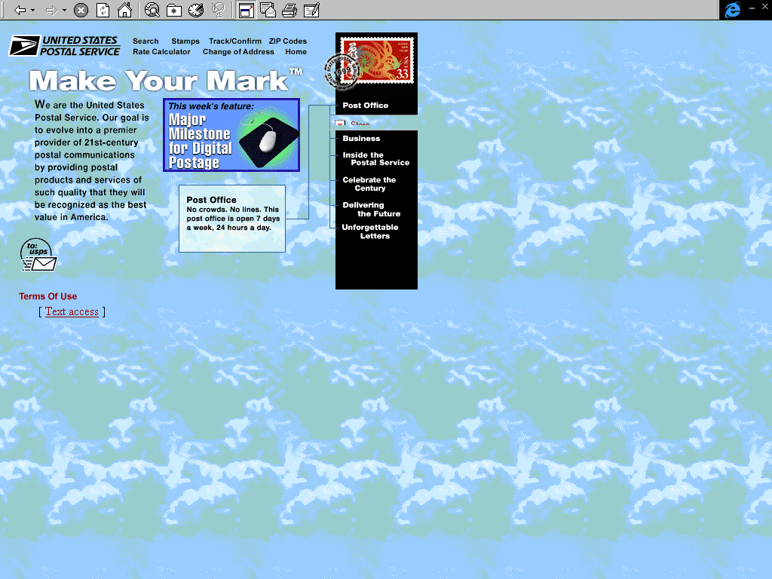
United States Postal Service
www.usps.com or www.usps.gov
Project Profile:
The U.S. Postal Service (USPS) requested assistance in 3 areas: Internet payment, certificate authority, and Internet business strategy. Key Client issues included: Enabling USPS to transfer universality and trust to the Internet, Preserve and grow market share, Provide infrastructure for secure payment and transactions. PwC Solution approach was to: Defined secure payment system policies and application program interface (API) requirements, Designed and developed a public key certificate authority infrastructure (internal and external), Designed and implemented an electronic post mark for USPS's e-mail system, Formulated an electronic bill presentment and bill payment strategy, Instituted multiple Internet sales channels for businesses and consumers, Provided overall strategic planning advice to USPS management on Internet services, Completed pilots for E-business and electronic post mark, Provided support for emerging certificate authority role, Constructed the strategy for electronic bill presentment and bill payment.
PwC Contact:
Project Partner: Paul Lawrence, Project Manager: Joe Casey

Slide 35
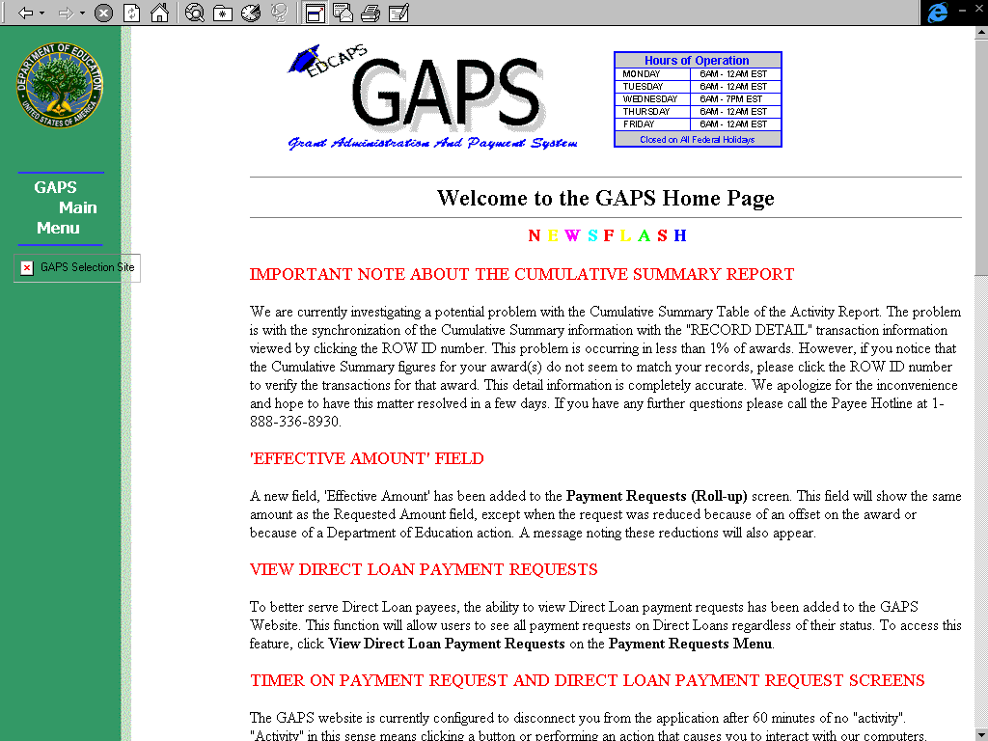
U.S. Department of Education
http://gapsweb.ed.gov
Project Profile:
The Education Automated Processing Systems (EDCAPS), which includes the core financials, procurement and contracting, grant administration and payment, and recipient management systems, is an integrated suite of applications supporting the Chief Financial Officer of the Department. The Grant Administration and Payment System (GAPS) is a custom system within EDCAPS that manages the entire grant life cycle from award through payment. GAPS includes a Web site that enables the over 15,000 grant recipients to review their award balances, financial transaction histories, and make payment drawdown requests. The site processed over $44 billion in payment requests during its first year. These requests are electronically transmitted to the recipients' bank accounts via electronic data interchange (EDI) transactions to the Federal Reserve Bank, ultimately enabling payments from the site to occur in the same business day.
PwC is the overall systems integrator for the project, and was the developer of the custom GAPS system. This project has totaled over $24 million in revenues and has option years through 2004.
PwC Contact:
Keith Taylor, Program Partner, (703) 741-2495, Morris Zwick, Program Manager, (703) 741-2575

Slide 36
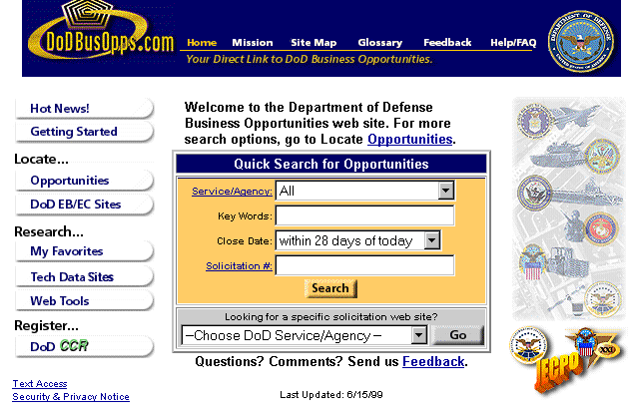
United States Department of Defense and Commerce
http://dodbusopps.com
Project Profile:
dodbusopps.com was conceptualized, designed, developed, and implement by PwC to assist users in the navigation, solicitation and bidding process for DoD Government Contracts. The DoDBusOpps in general consists of a three-tiered pyramid model. dodbusopps.com links the three tiers. Tier three - consists of hundreds of DoD solicitation websites that exist at the subcomponent levels, tier two - each of the DoD components (Army, Navy, DLA, DISA and Air Force) have taken the initiative of reeling in the Tier Three sites and have created a clearinghouse of solicitation data for most or all of their solicitations that are generated, tier one - consists of dodbusopps.com. This site receives a metadata feed from each of the Tier Two sites. The metadata is then indexed into our databases, at which point the users can enter search criteria and find out if solicitations exist based on their criteria. If they do exist, the site provides links to the actual solicitation and where it exists natively, any technical data repository associated with it, links to the CCR website to register, and to the bidding module of the Tier Two site.
PwC Contact:
Anand Paul

